Slide 1
ONLINE FOOD DELIVERY SYSTEM
GROUP – 6
TEAM MEMBERS:
1. Alugubelly Madhuri
2. Koppolu Venkata Teja
3. Pidugu Pravalika
4. S Bindhu
5. Shrinath Shivaji Magdum
6. Devarinti Anusha
7. Kamsala Sai
8. Pandey Aishwarya Jyothi
9. Pragya Upadhyay
10. Reddem Himabindu

Slide 2
Reference
www.google.co.in
www.youtube.com
www.w3schools.com
www.javatpoint.com

Slide 3
Contents
Objectives
Introduction
Tools & languages used
System Requirements
Existing System
Proposed System
List of Function
UML Diagram
App Flow
Spring MVC Pattern
Scope and Improvement
Conclusion

Slide 4
Objective
The main objective of the Online Food Ordering System is to manage the details of Item Category, Food, Delivery Address, Order, Shopping Cart. It manages all the information about Item Category, Customer, Shopping Cart, Item Category.
Practically : The system is quite stable and can be operated by the people with average intelligence
Efficiency : We tried to involve accuracy, timeliness and comprehensiveness of system output.
Cost : It is desirable to aim for the system with a minimum cost subject to the condition that it must satisfy the requirements provided.

Slide 5
Introduction
ONLINE FOOD ORDER SYSTEM is mainly designed primarily function for use in the food delivery industry.
This system will allow hotels and restaurants to increase online food ordering such type of business.
The customers can be selected food menu items just few minutes.
In the modern food industries allows to quickly and easily delivery on customer place.
Restaurant employees then use these orders through an easy to delivery on customer place easy find out navigate graphical interface for efficient processing.

Slide 6
Tools & Languages used
Frontend
Visual Studio
Angular
HTML
CSS
BOOTSTRAP
Backend
Spring-Boot
Hibernate
MySQL
IntelliJ IDEA

Slide 7
System Requirements
The Basic System Requirements for Running this project are listed below:
Angular, STS and MySQL to be installed to the system
572 MB Random Access Memory
200 MB of Free Space on Hard Disk
Microsoft Windows XP or Linux or Equivalent OS
Web Browser Internet Explorer Version 10

Slide 8
Existing System
In existing system for giving any orders users should visit hotels or restaurants to know about food items and them give order and pay advance.
In this method time and manual work is required.
Maintaining critical information in the files and manuals is full of risk and a tedious process.
Time consuming process .

Slide 9
Proposed System
Our proposed System helps to make food ordering simple and to deliver food at the doorstep.
Customers can choose their favorite food ,order and make payments online.
This system helps to reduce the time of customers and get Quality foods on time.

Slide 10
List of Admin Function
Admin
1. Adding number of Restaurants.
2. With user name and Password.

Slide 11
List of Restaurant Functions
Restaurants:
Adding type of category.
Adding food items types.
Show Orders from Customers.
accept and preparing food.
deliver to this food item to customers

Slide 12
List of Customer
Customer
Sing up and sing in for customer.
Display Number of Restaurants present.
Select one Restaurants.
Choose food item to order.
Pay the amount.

Slide 13
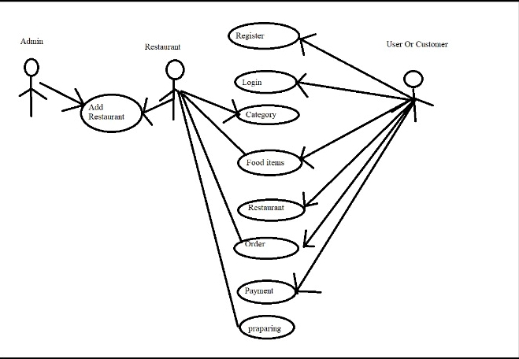
UML Diagram

Slide 14
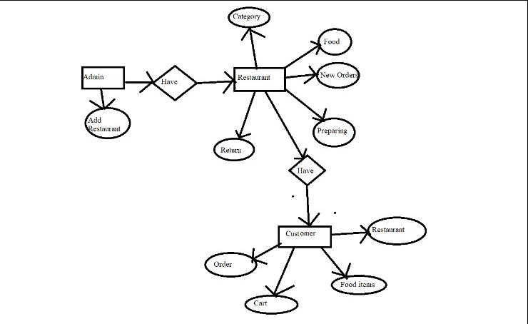
App Flow

Slide 15
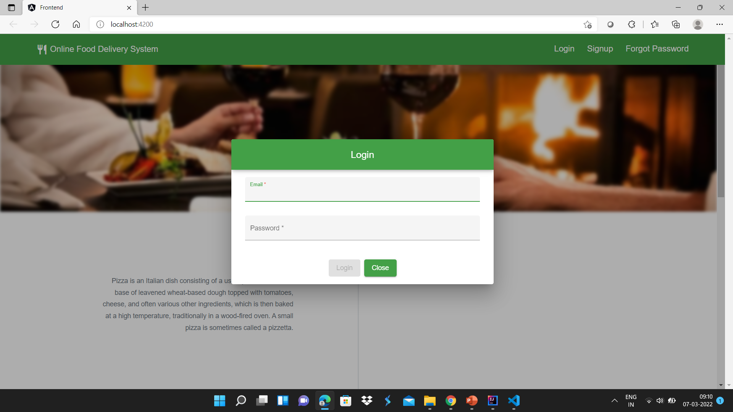
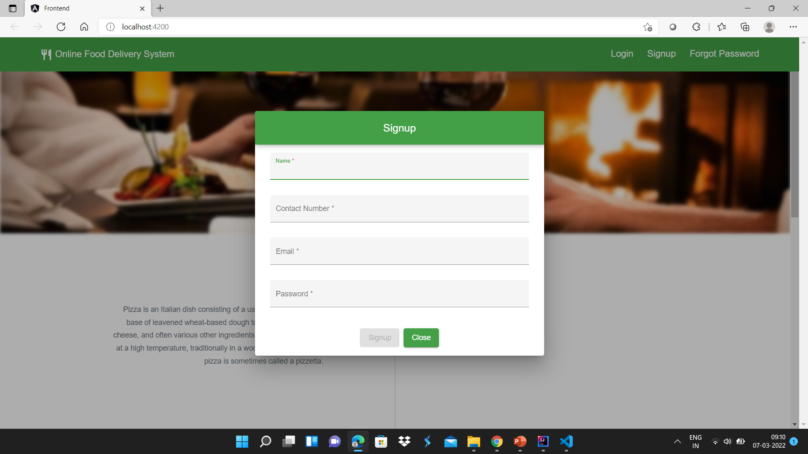
Home Page

Slide 16
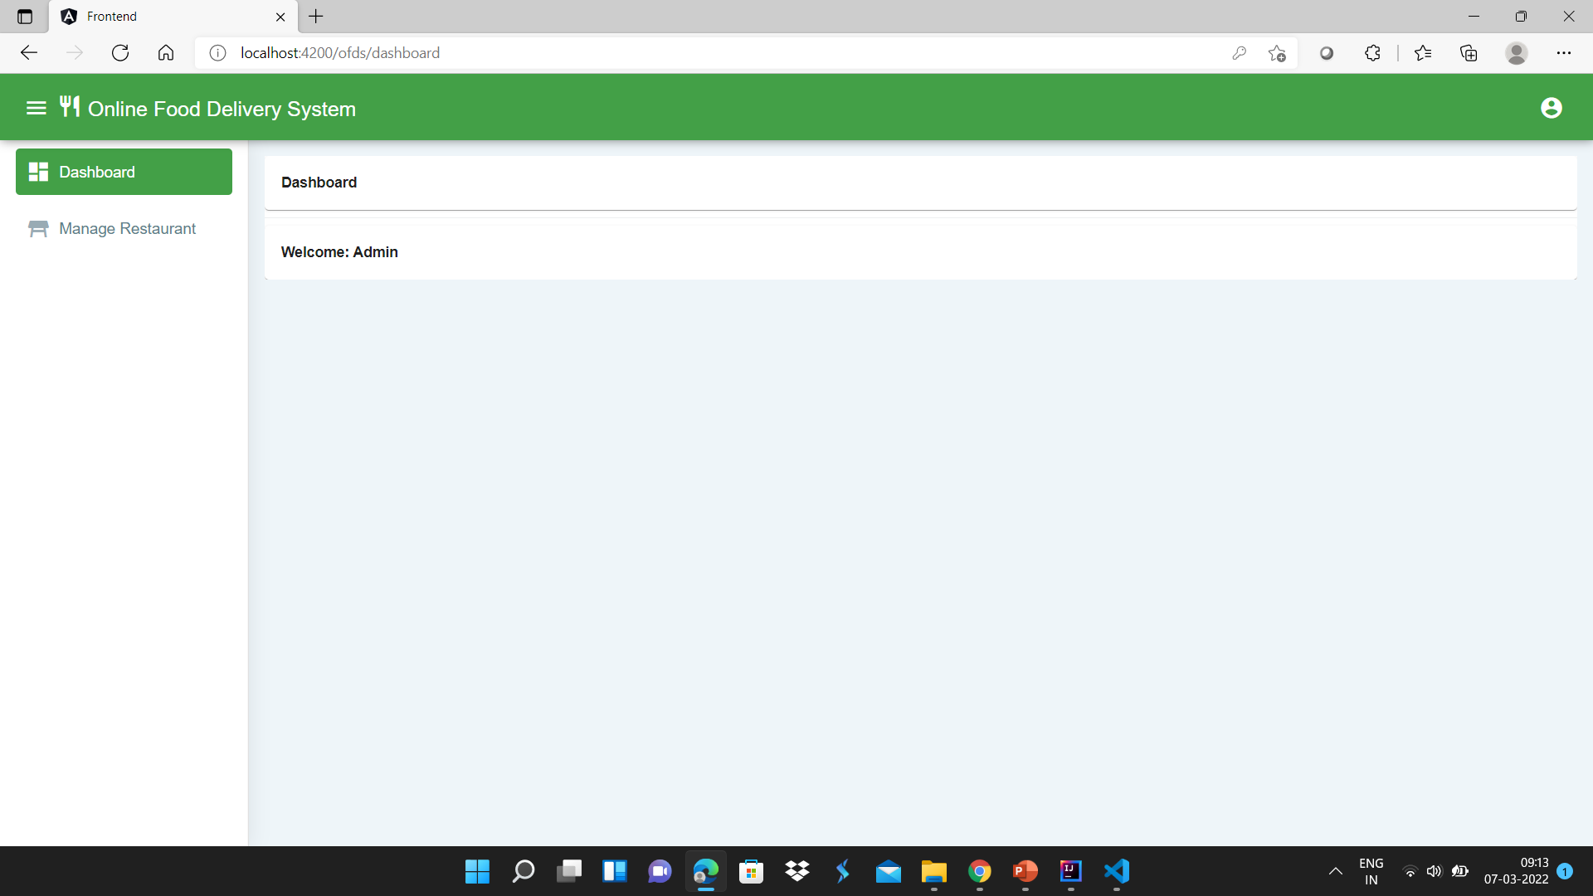
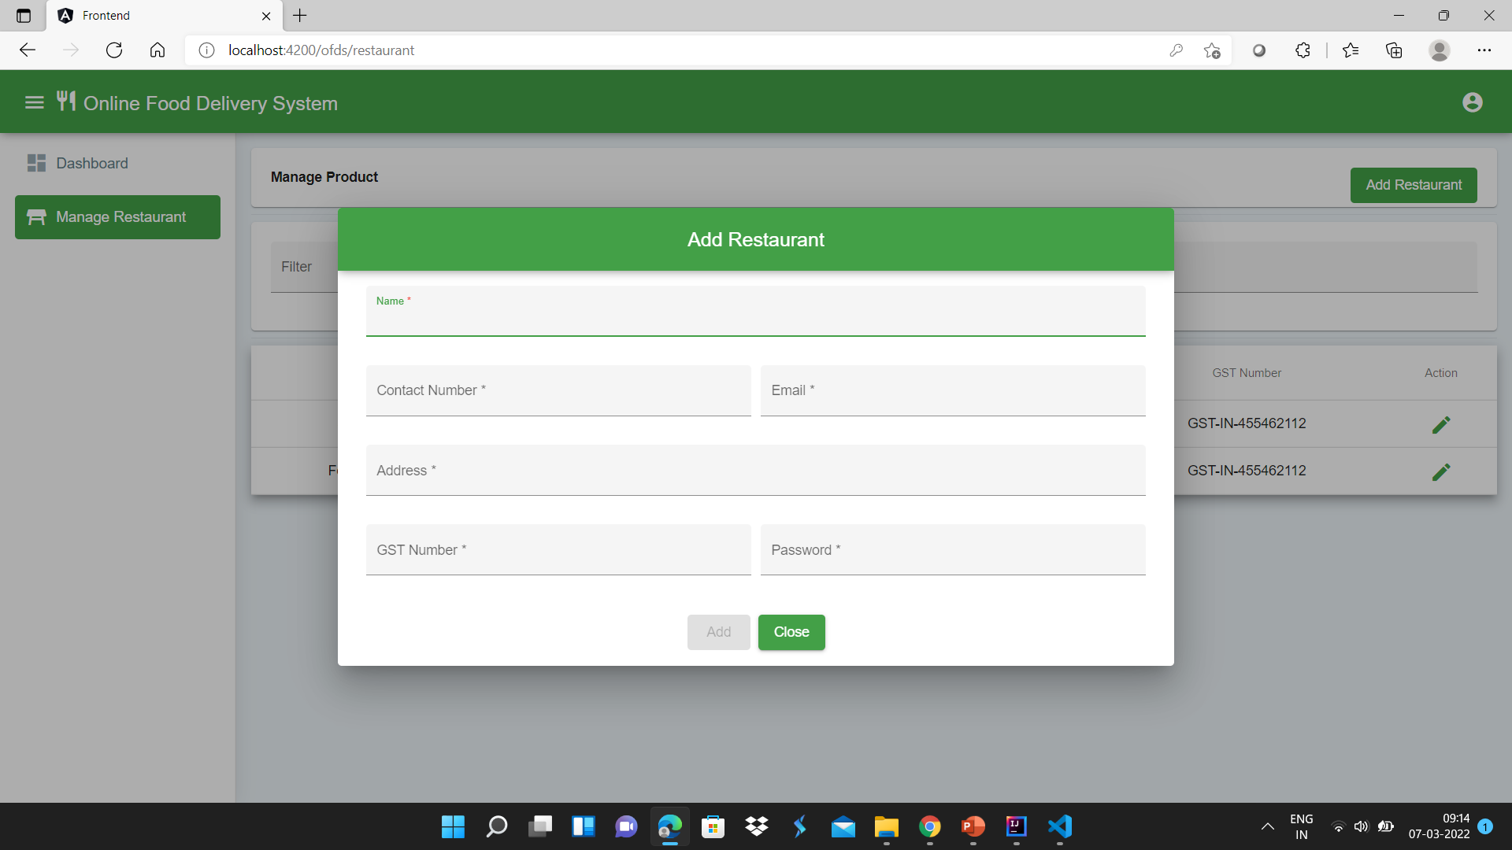
Admin Functions

Slide 17
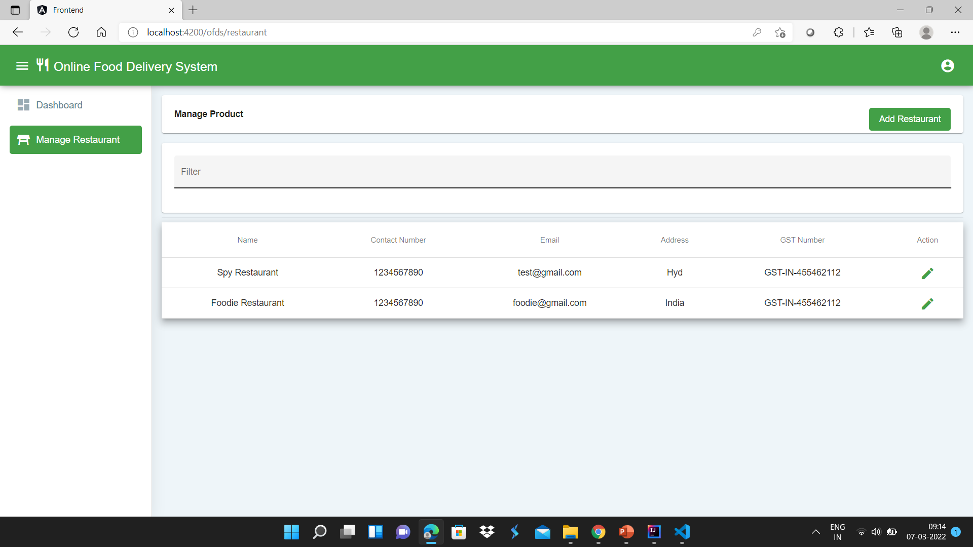

Slide 18
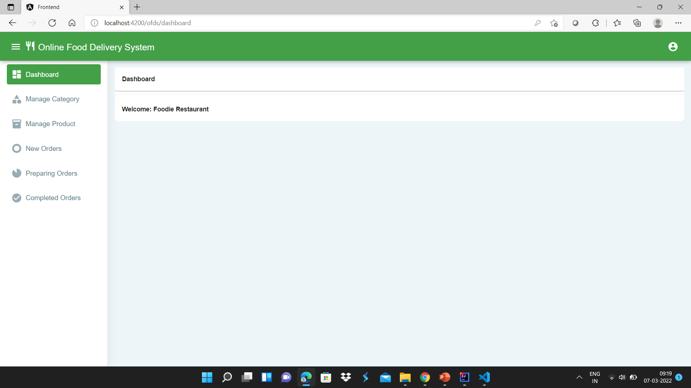
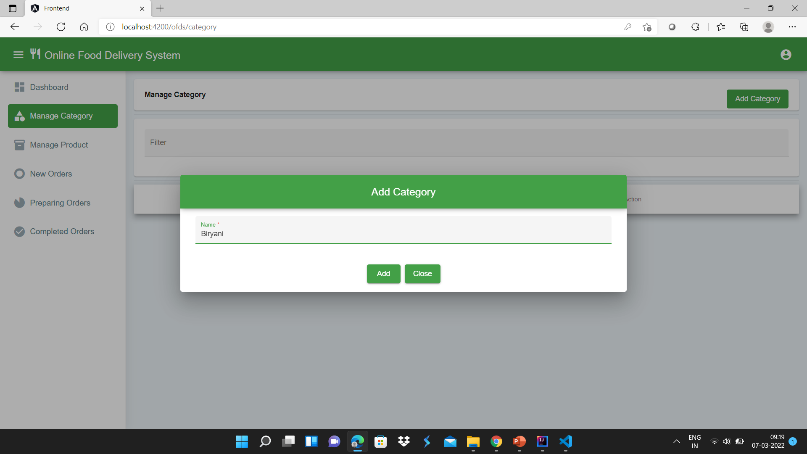
Restaurant Functions

Slide 19
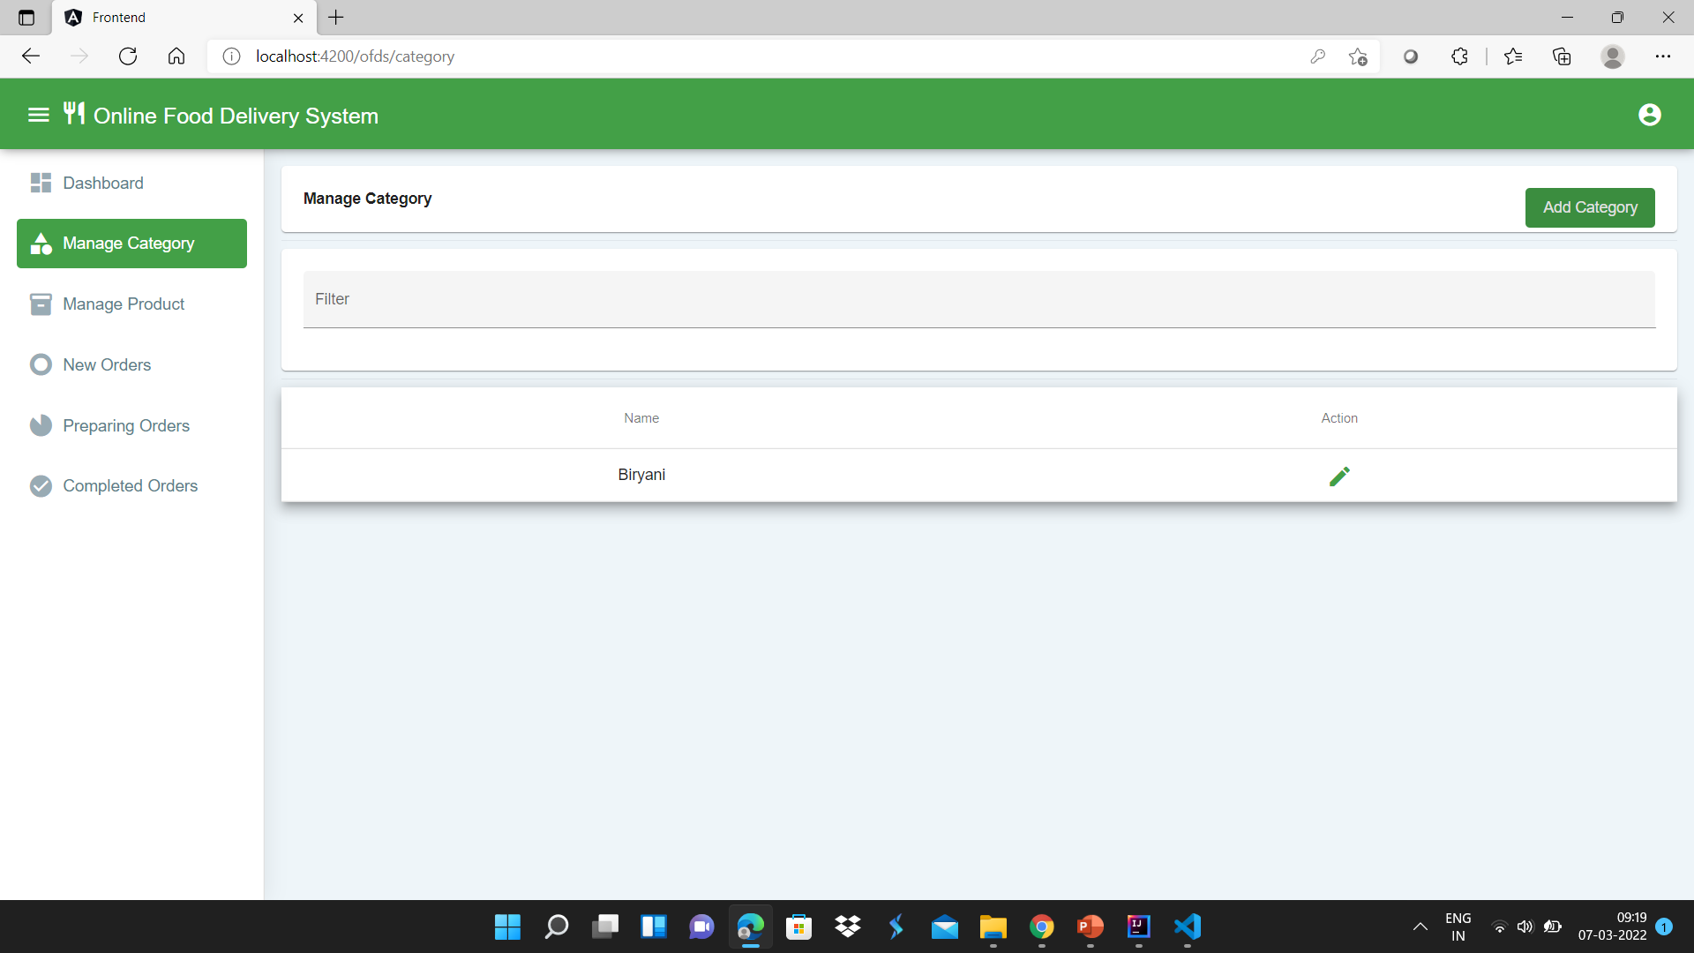
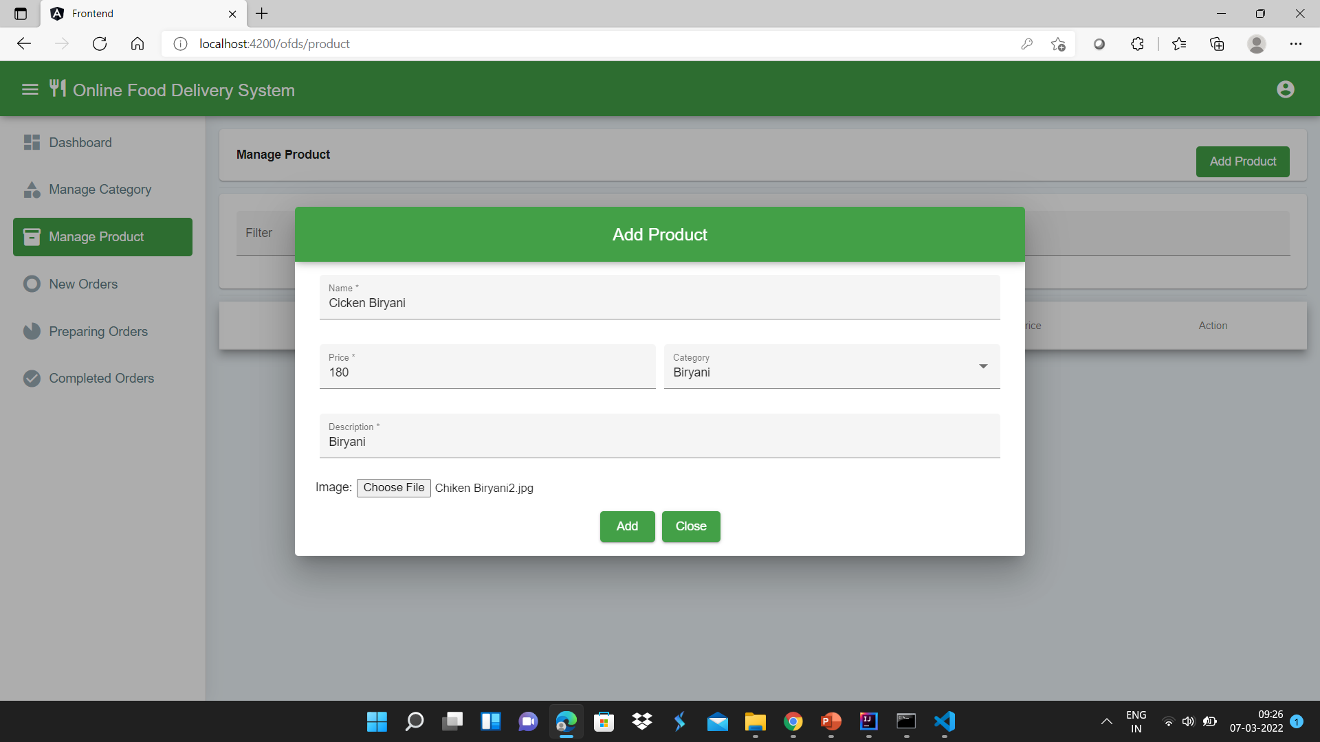

Slide 20
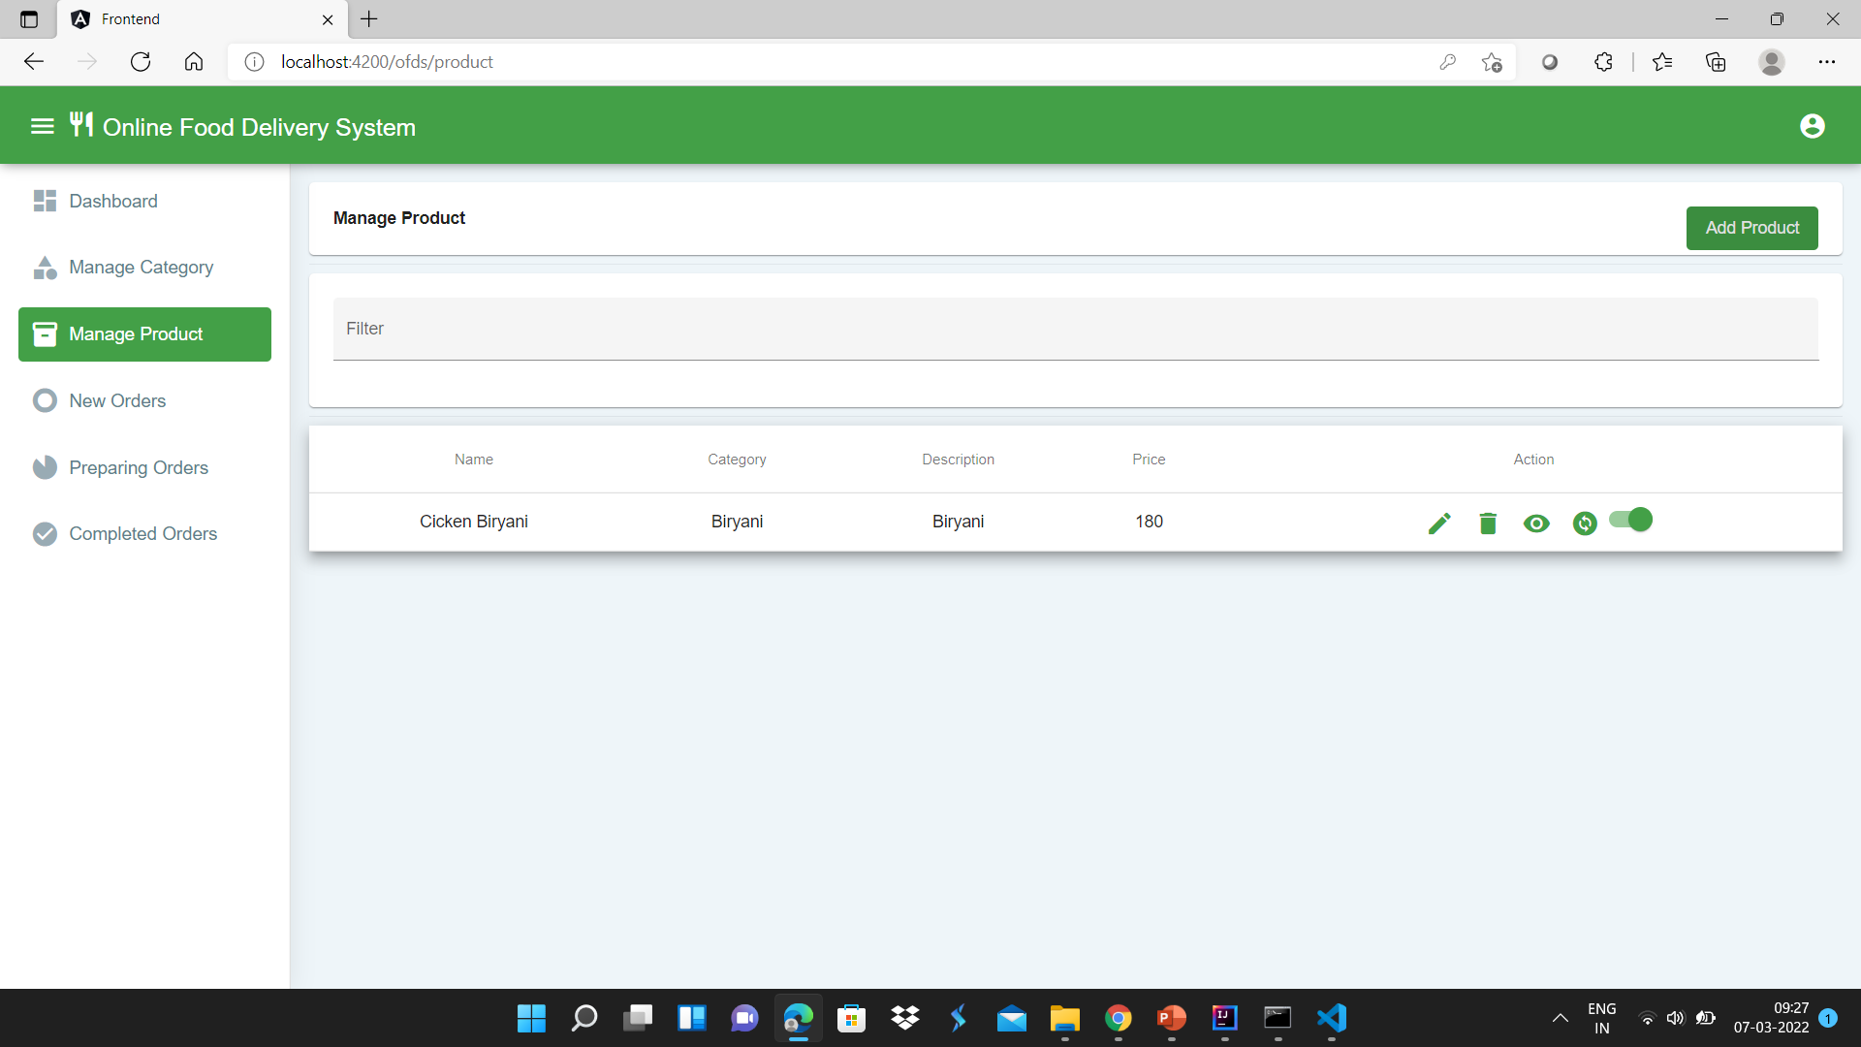

Slide 21
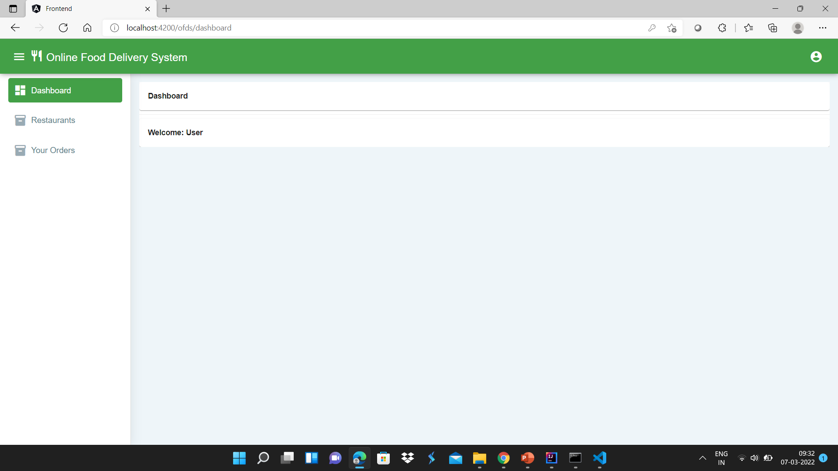
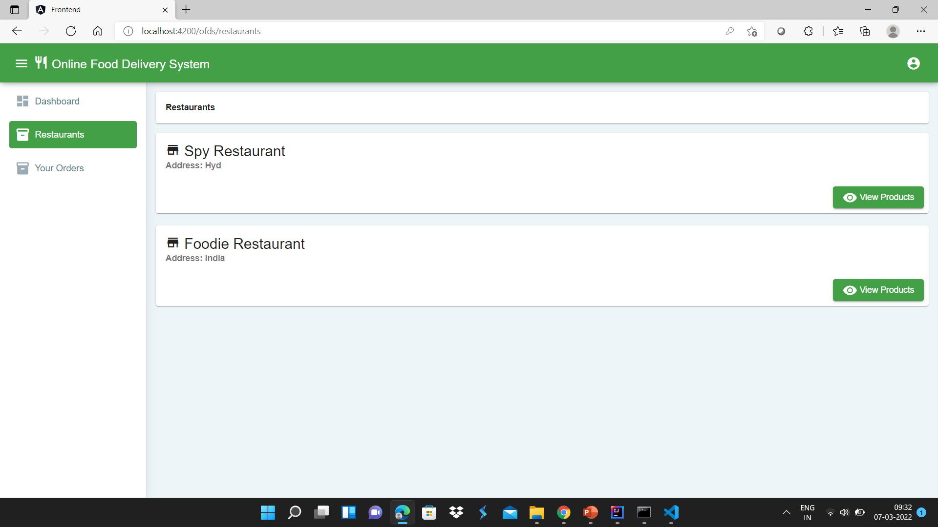
Customer function

Slide 22
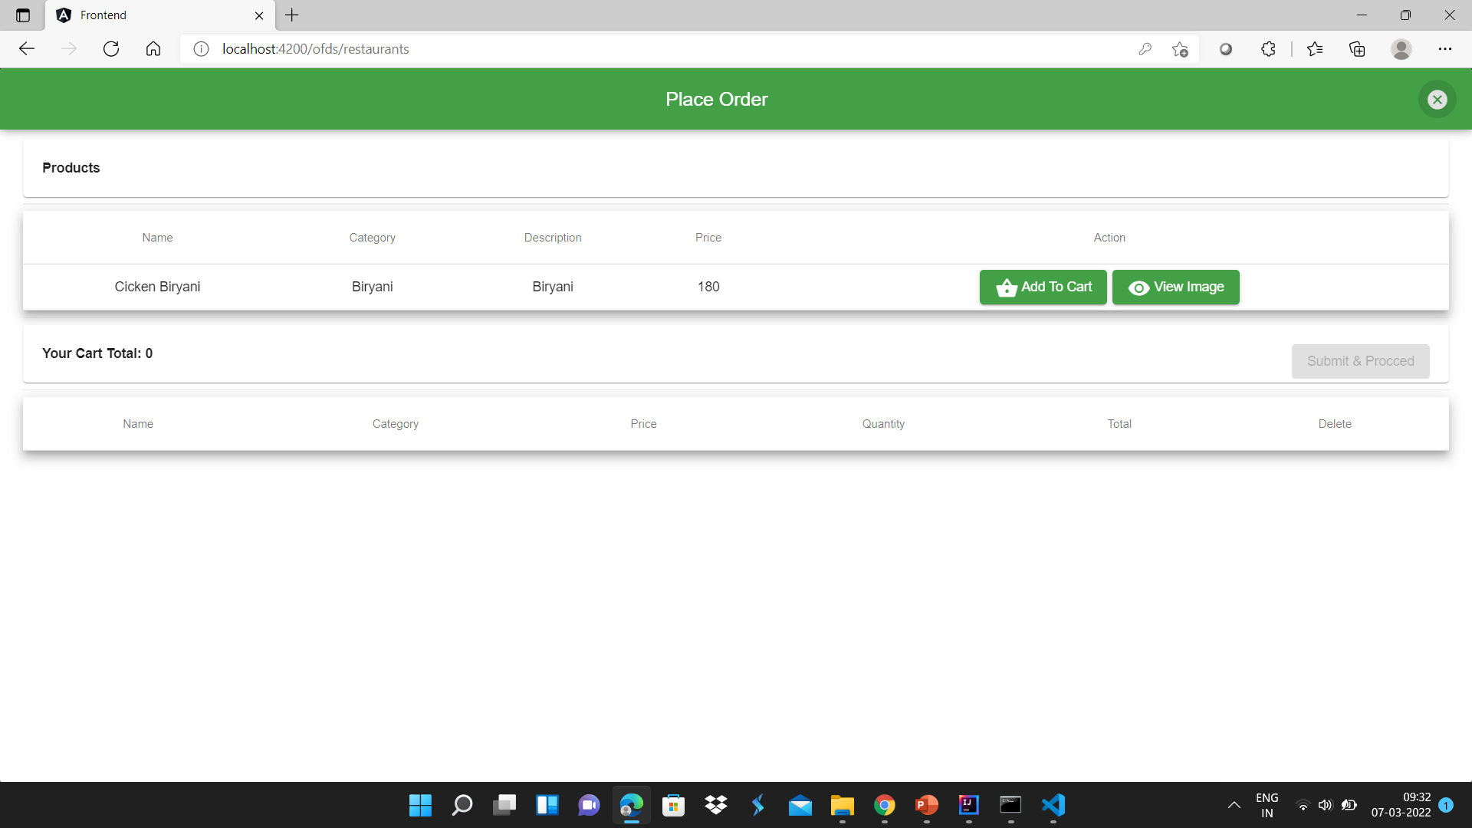
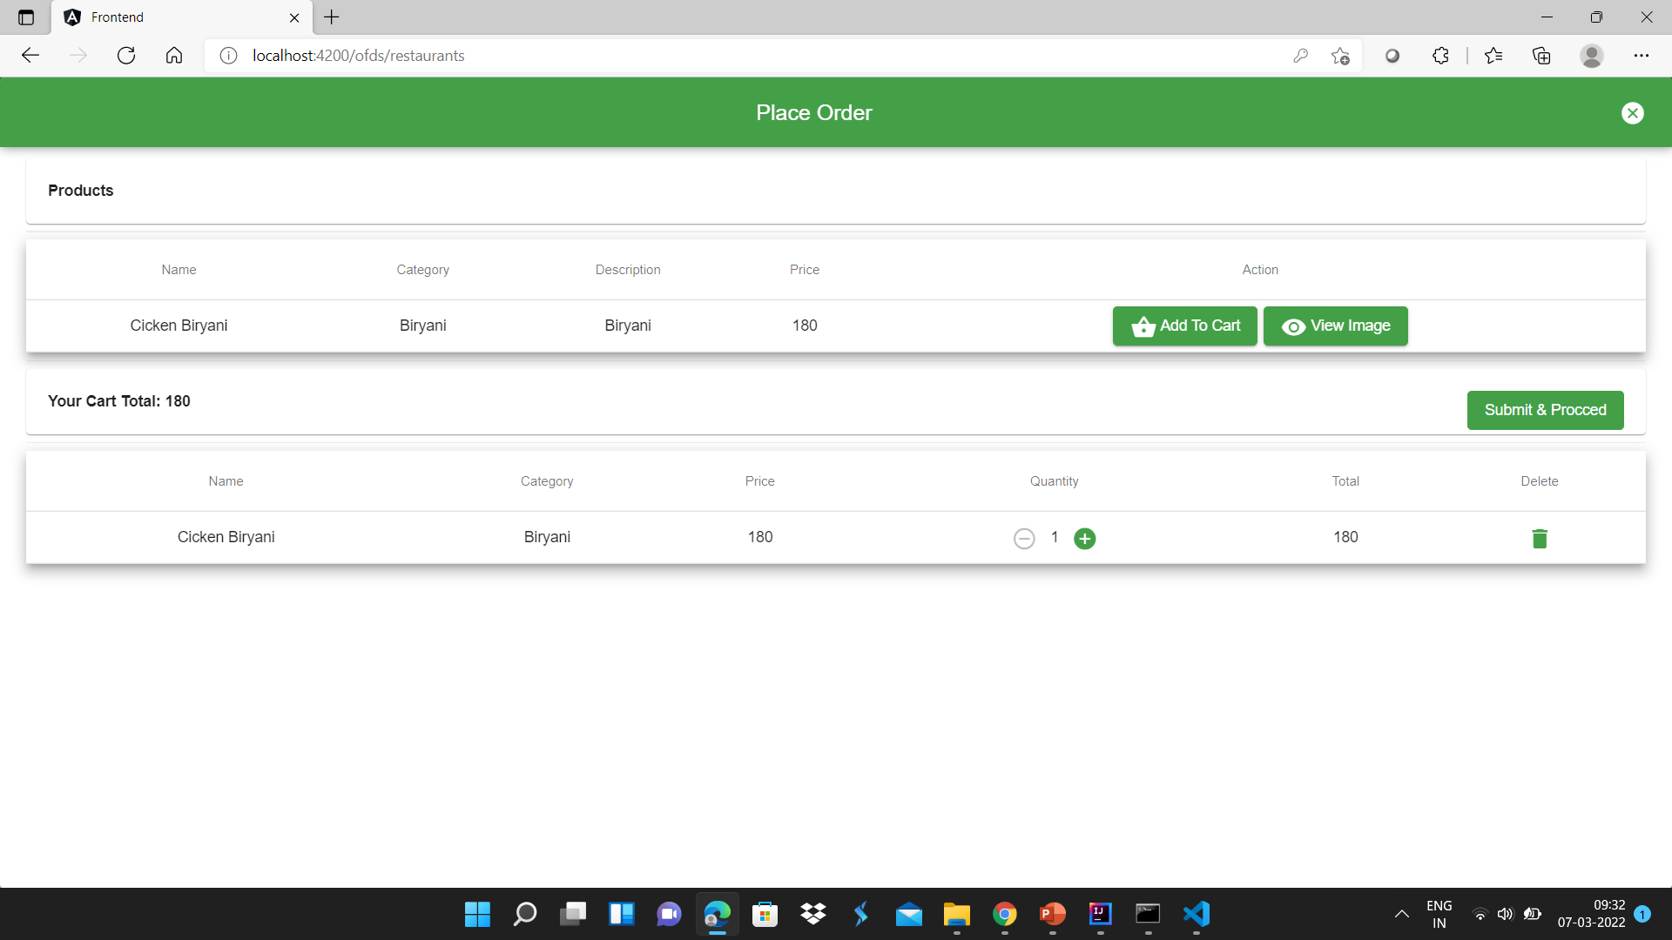

Slide 23
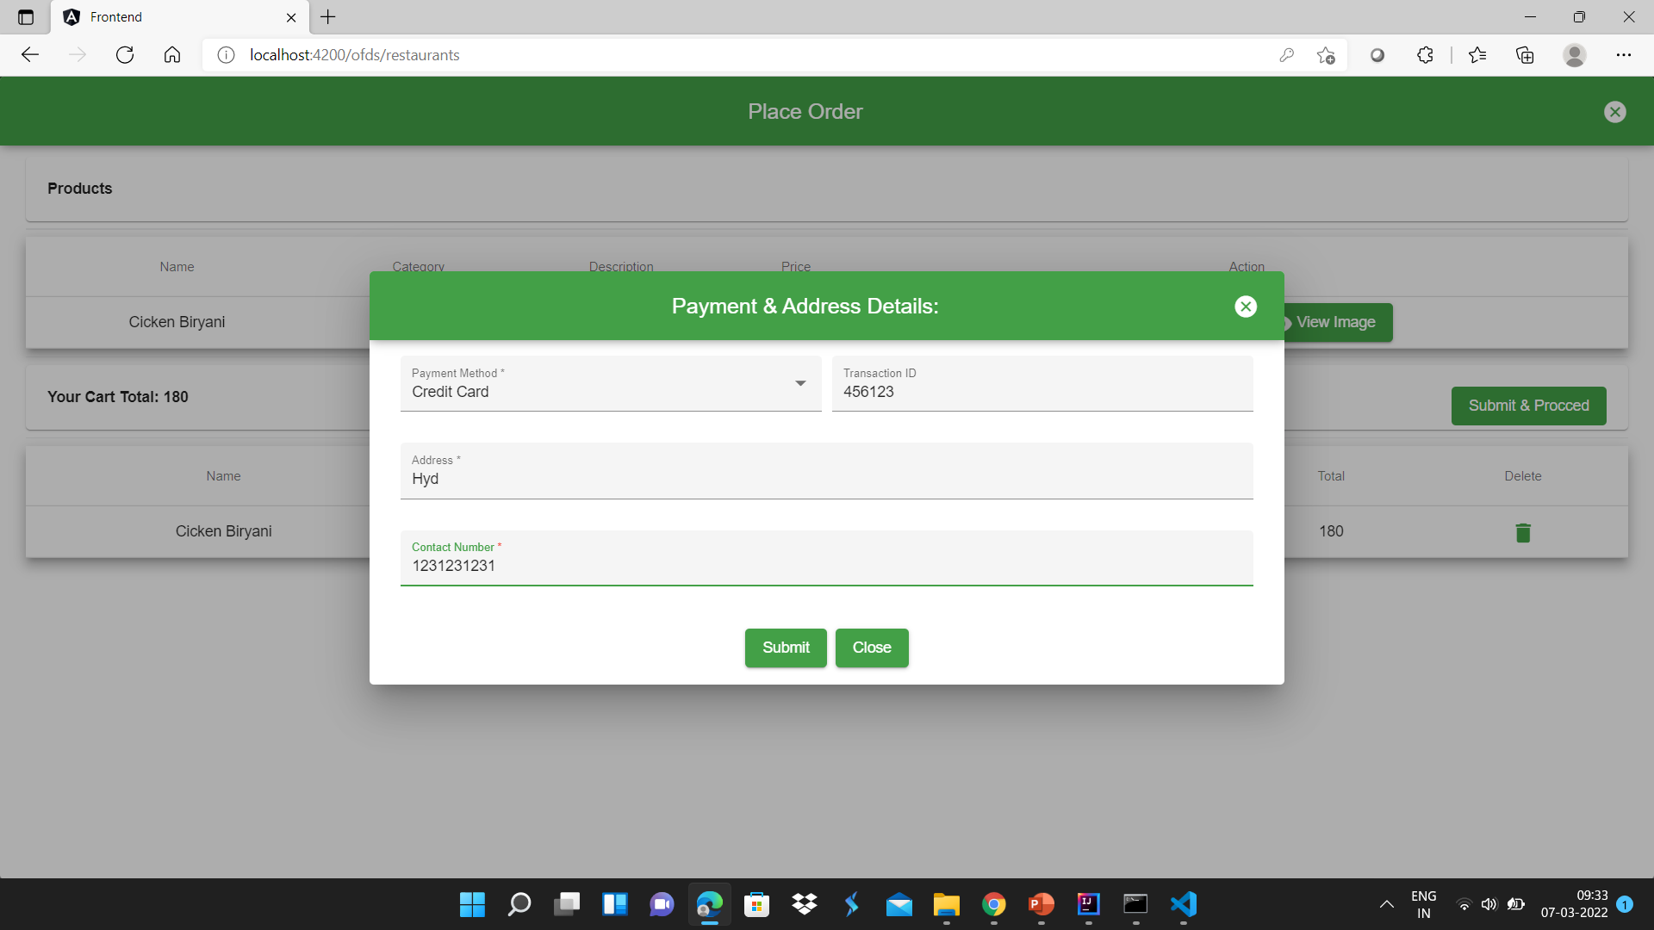
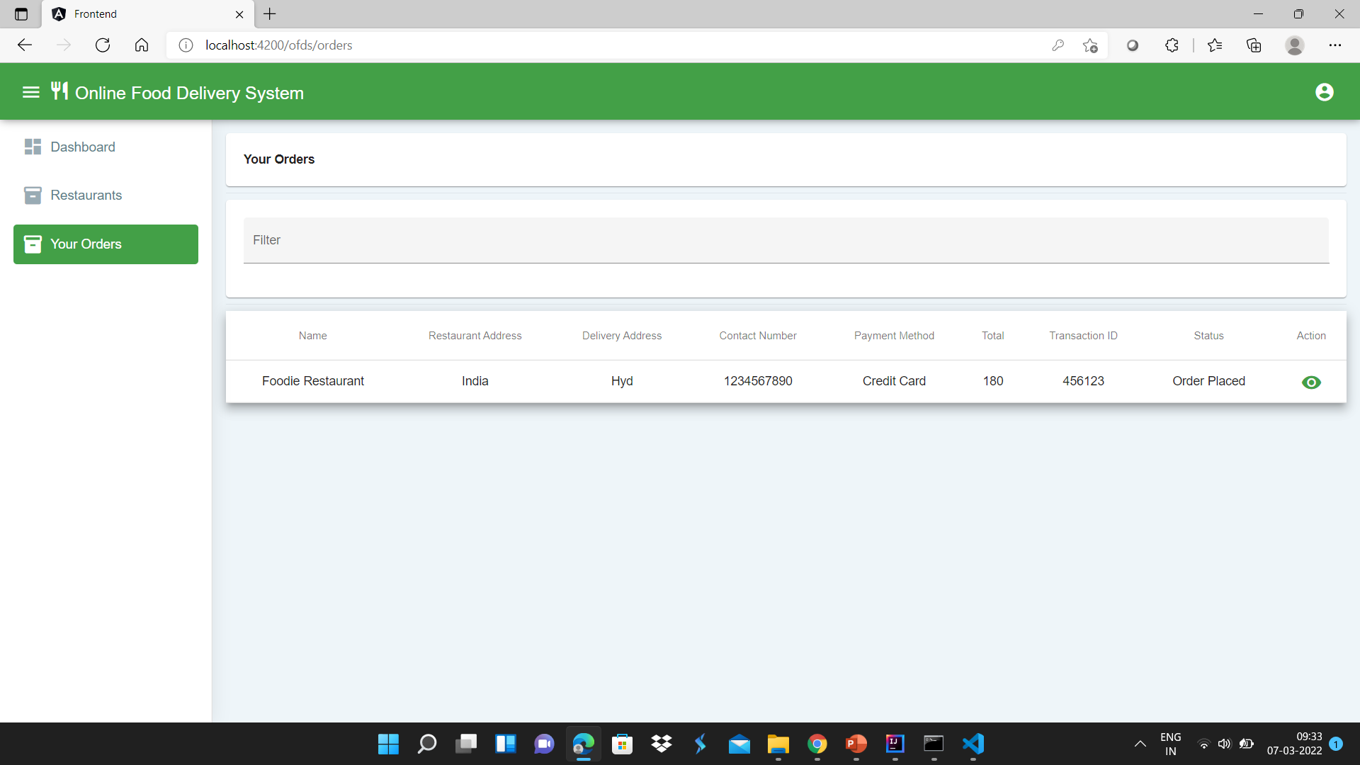

Slide 24
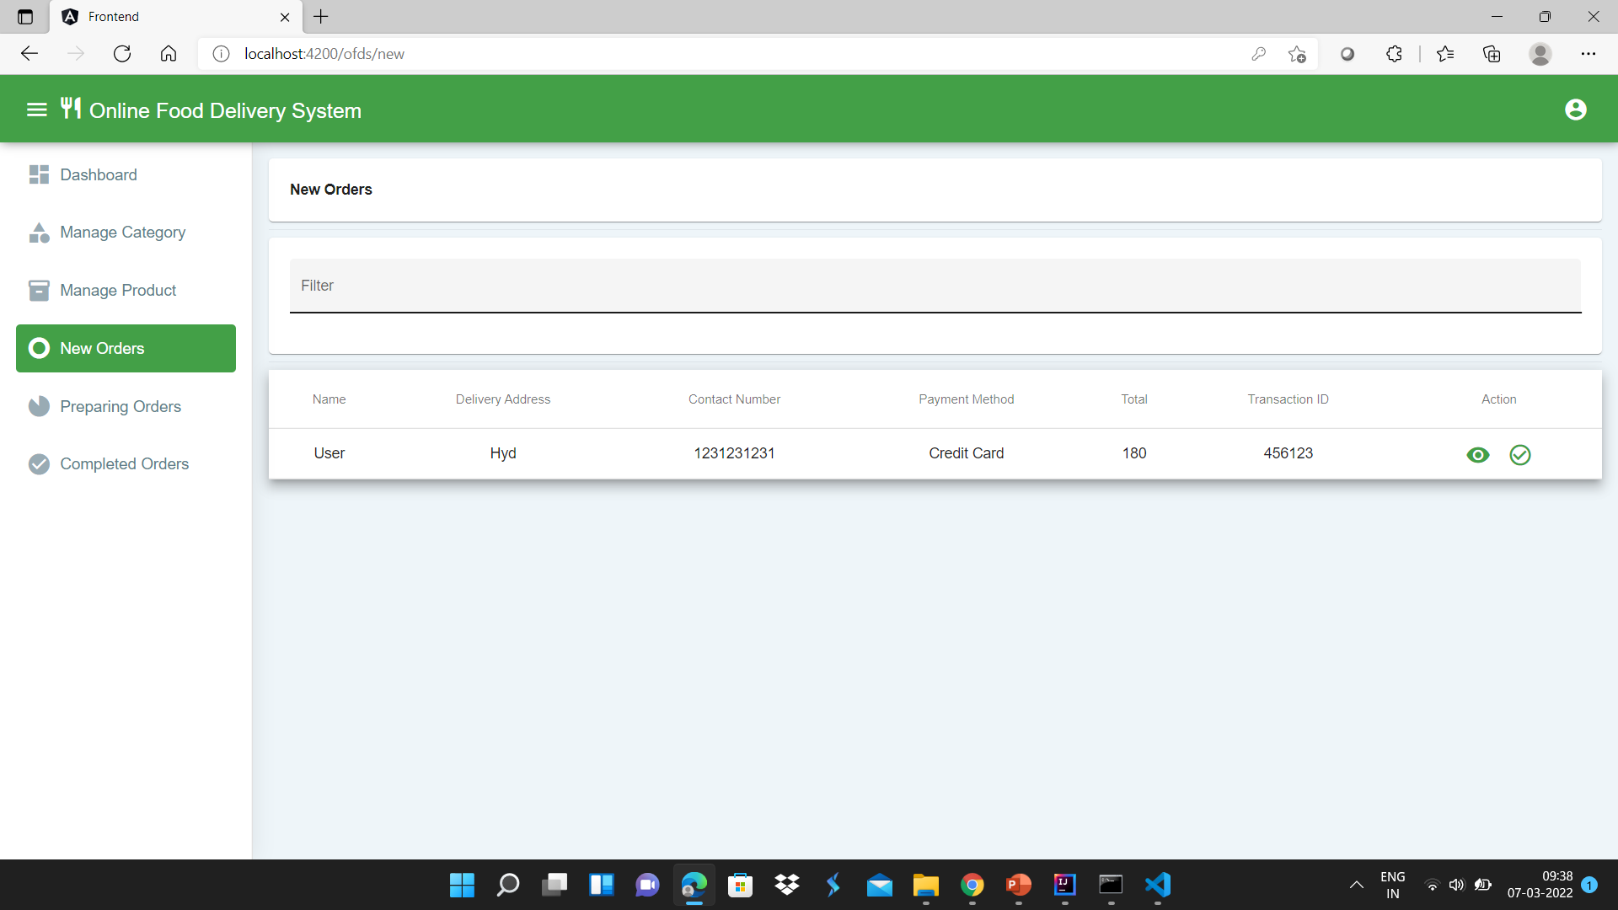
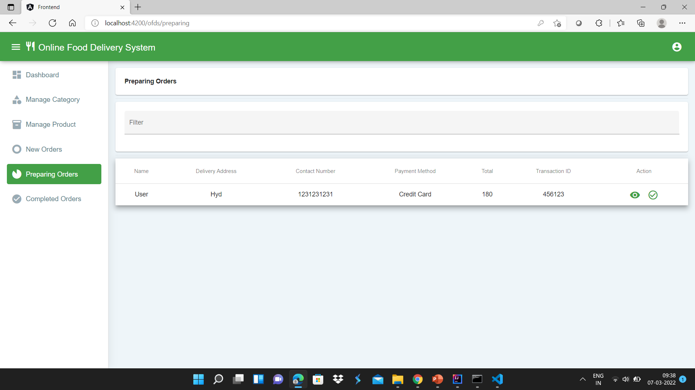

Slide 25
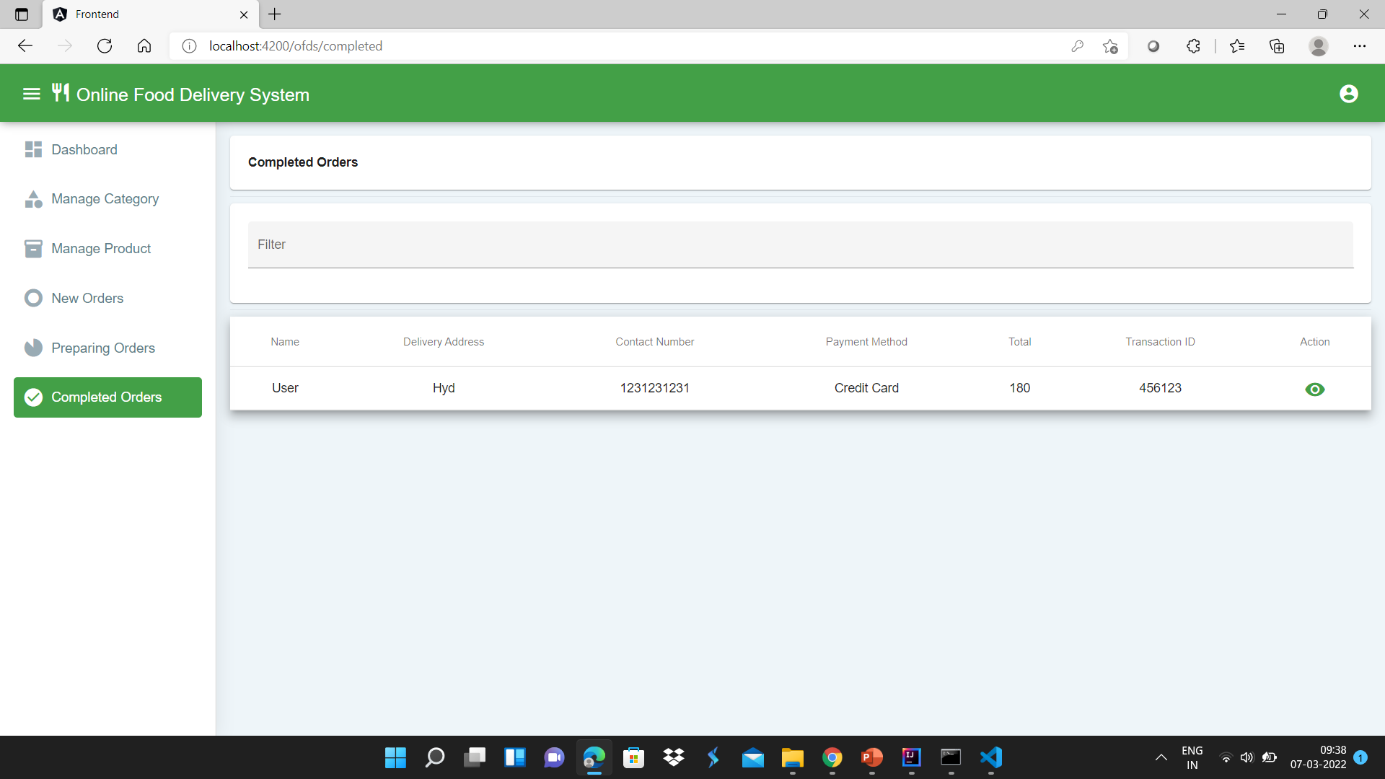


Slide 26
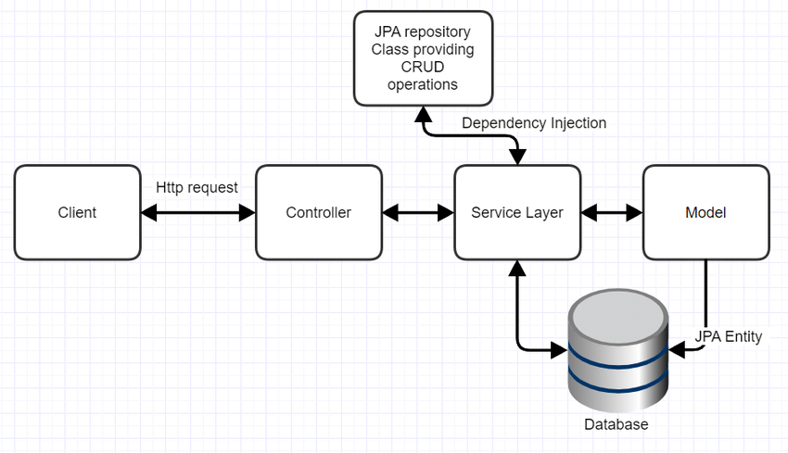
Spring MVC Pattern

Slide 27
Scope and Improvement
The Scope of the project (Android / web panel based application) are as follows: Food Ordering app can sale Food product, preferred brands, kitchen needs, essential restaurant supplies and more, through this online, one- stop Food store.
It provides you with a convenient way to sale from your Food shopping app.

Slide 28
Conclusion
An Online Food Ordering System is proposed here which simplifies the food ordering process.
The proposed system shows an user interface and update the menu with all available options so that it eases the customer work.

